Slide 1
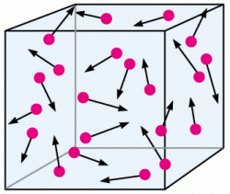
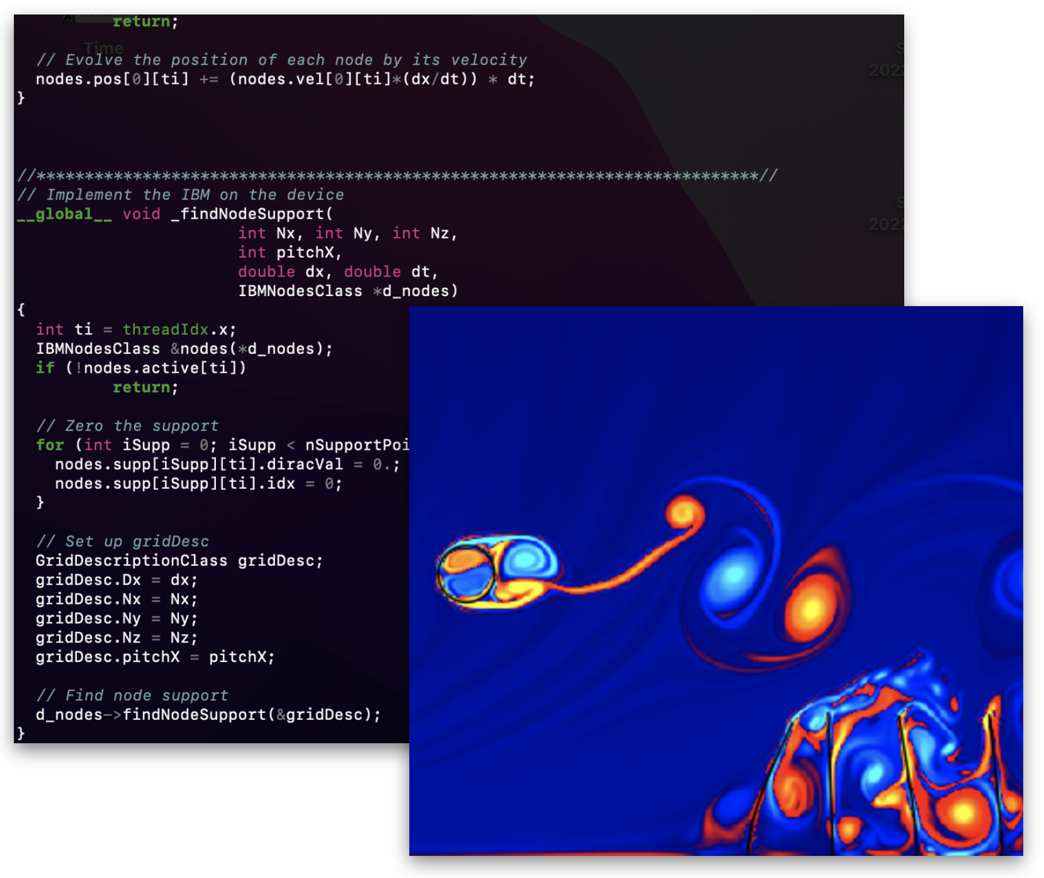
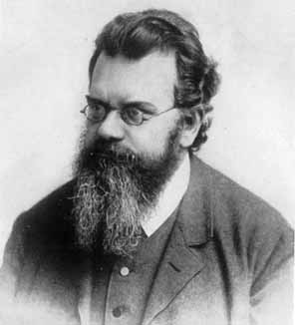
Lattice Boltzmann method: Let’s suit up! Part I
Alessandro De Rosis
Lecturer in Virtual Engineering
Department of Mechanical, Aerospace and Civil Engineering (MACE)
The University of Manchester

Slide 2
Outline
2
Lattice Boltzmann method (LBM): what is it?
Hands-on session

Slide 3
Outline
3
Lattice Boltzmann method (LBM): what is it?
Hands-on session

Slide 4
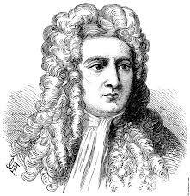
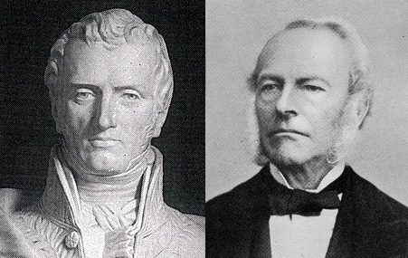
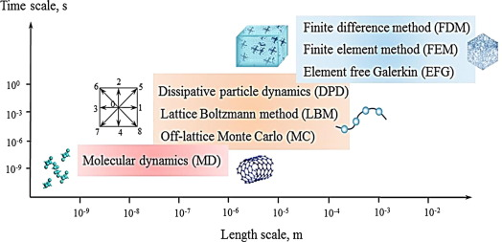
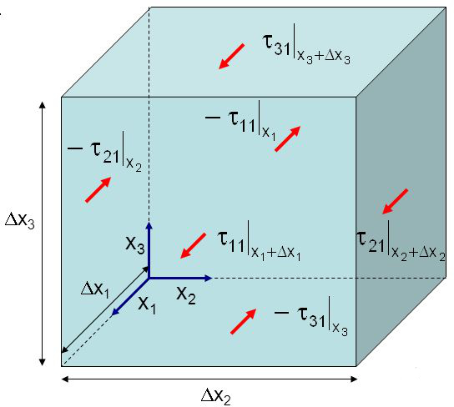
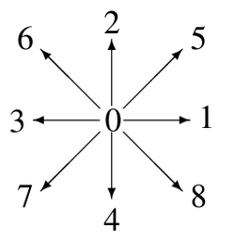
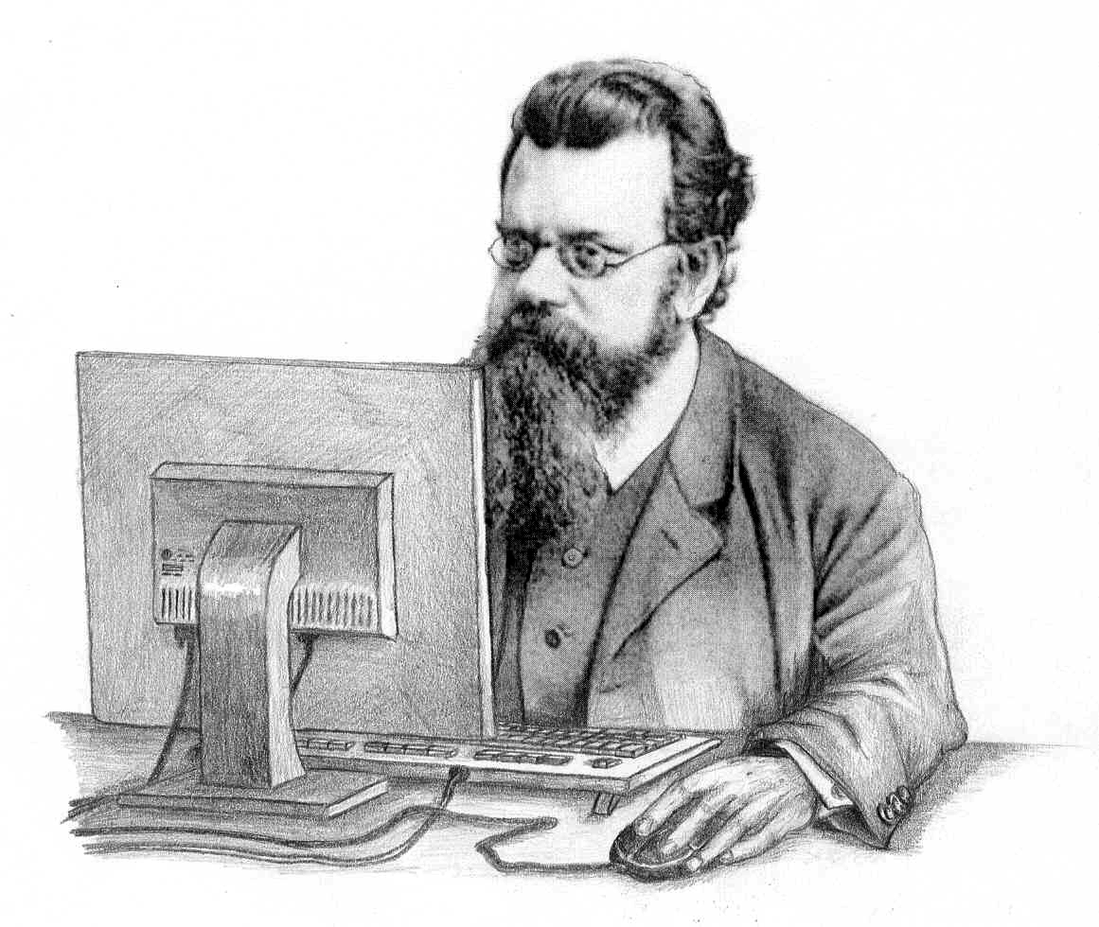
Numerical simulations of fluid dynamics
4
Microscopic
Kinetic
Macroscopic
Time scale [s]
Finite difference method
Finite volume method
Element free Galerkin
v
10⁰
Dissipative particle dynamics
Lattice Boltzmann method (LBM)
Off-lattice Monte Carlo
10⁻³
10⁻⁶
10⁻⁹
Molecular dynamics
v
10⁻⁹
10⁻⁸
10⁻⁷
10⁻⁶
10⁻⁵
10⁻⁴
10⁻³
10⁻²
Length scale [m]
The 10-orders-of-magnitude hierarchy

Slide 5
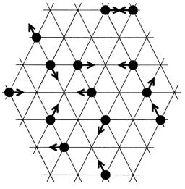
Lattice Boltzmann method
5
Lattice
Boltzmann
(Kinetic theory)

Slide 6
Why LBM?
6
Navier-Stokes equations…

Slide 7
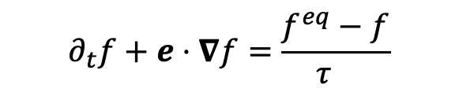
Why LBM?
6
Navier-Stokes equations…
ADVANTAGES
No moving meshes
Nonlinearity is local, nonlocality is linear
Easy implementation
…Boltzmann equation
$$∂_{t}f+e⋅∇f=\frac{f^{eq}−f}{τ_{}}$$

Slide 8
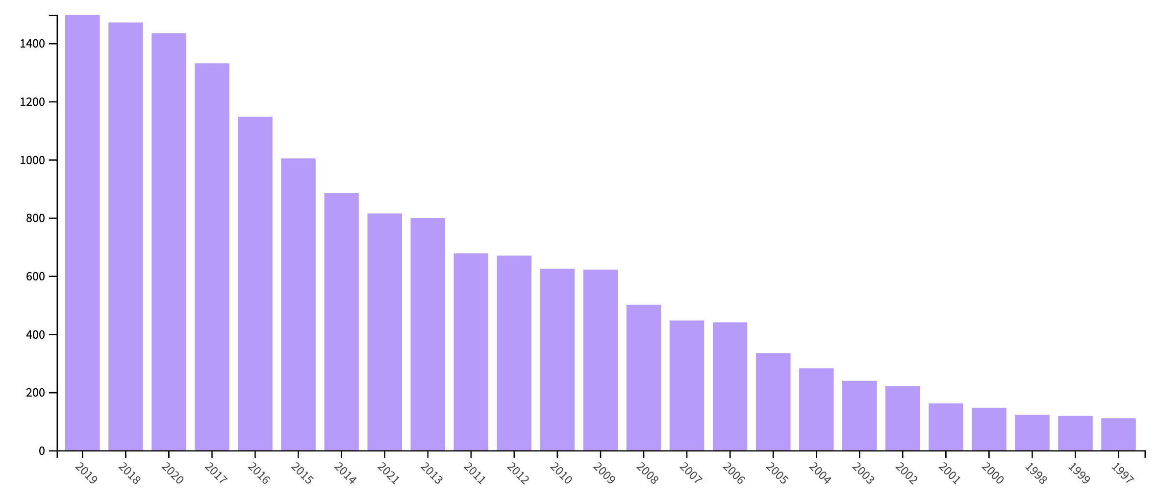





Why LBM?
6
Navier-Stokes equations…
ADVANTAGES
No moving meshes
Nonlinearity is local, nonlocality is linear
Easy implementation
Increasing recognition from academia and industry
…Boltzmann equation
$$∂_{t}f+e⋅∇f=\frac{f^{eq}−f}{τ_{}}$$
Screenshot 2021-07-15 at 17.48.29
Documents per year
Scopus

Slide 9
Why LBM?
6
Navier-Stokes equations…
ADVANTAGES
No moving meshes
Nonlinearity is local, nonlocality is linear
Easy implementation
Increasing recognition from academia and industry
Suited for complex physics
…Boltzmann equation
$$∂_{t}f+e⋅∇f=\frac{f^{eq}−f}{τ_{}}$$
Screenshot 2021-07-15 at 17.48.29
Documents per year
Scopus

Slide 10



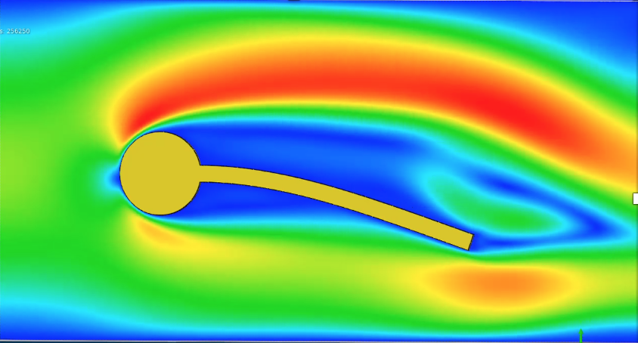
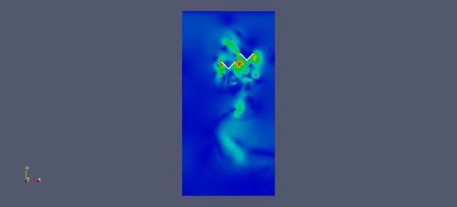
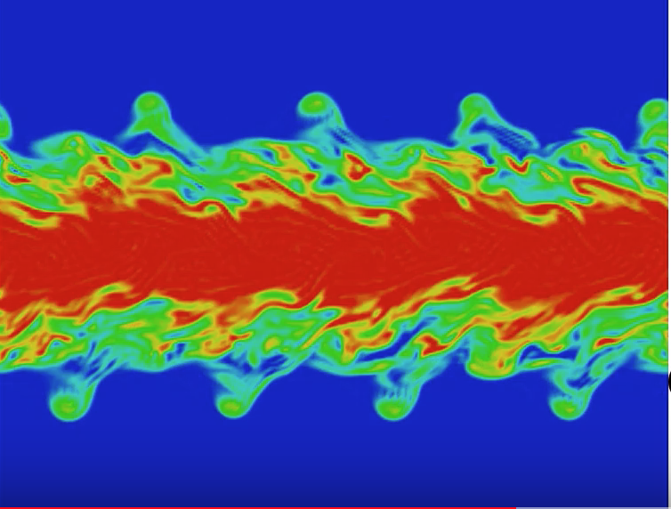
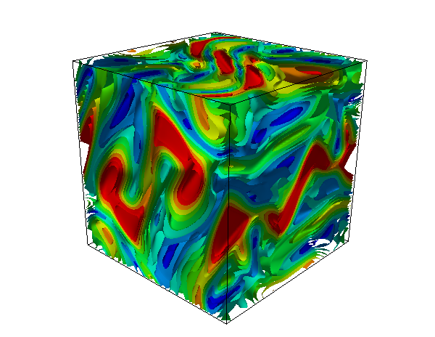
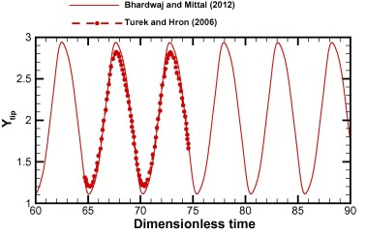


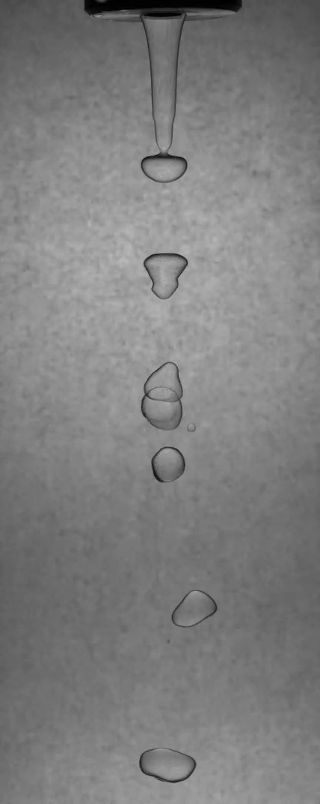
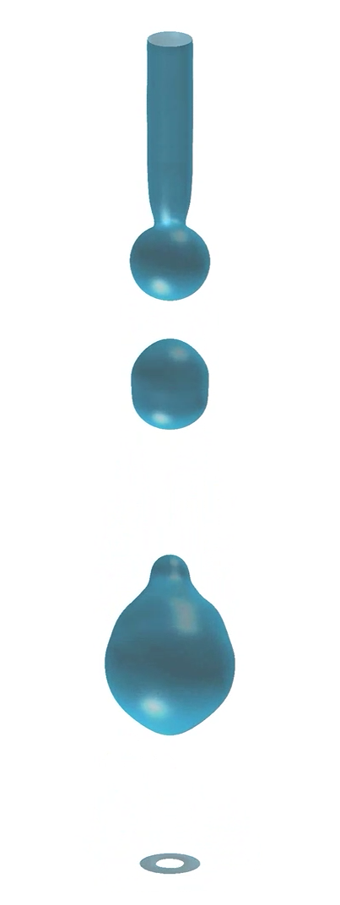
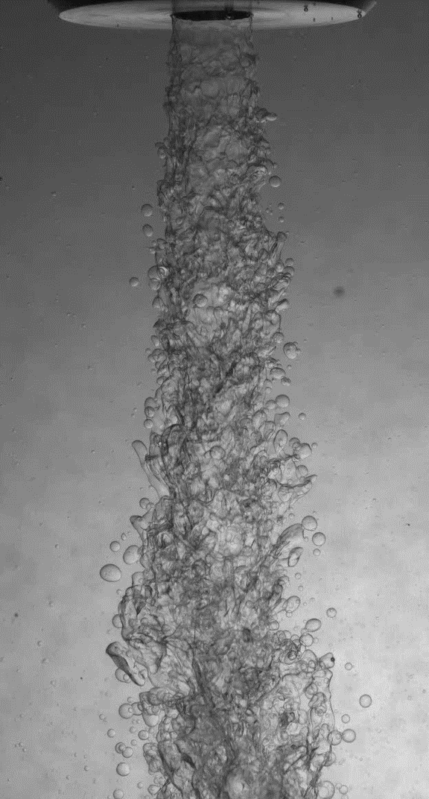
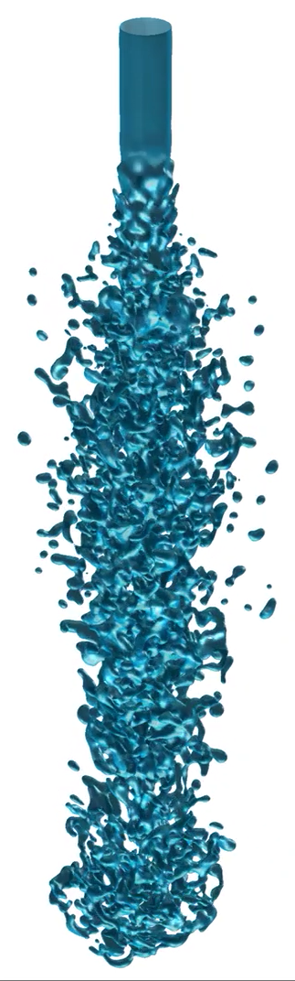
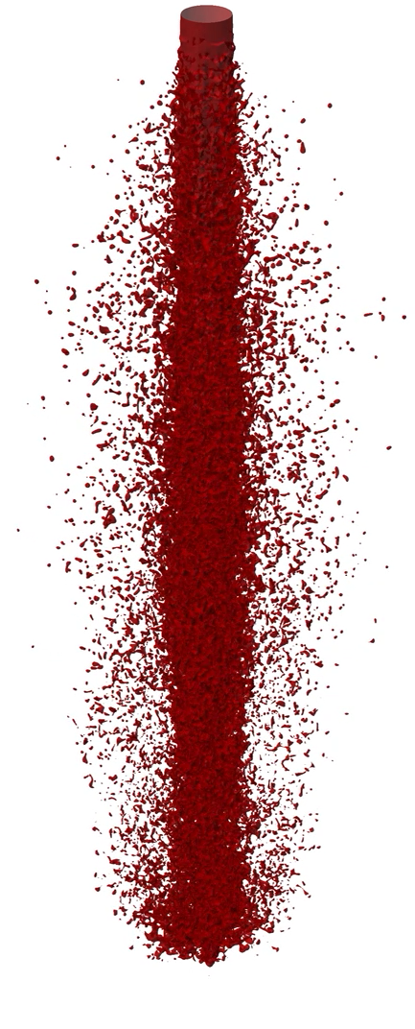
Multiphysics modelling by LBM
7
Fluid: LBM
Solid: FEM
IBM
THEORY OF LBM & NUMERICAL SIMULATIONS
Fluid-structure interaction
Turbulence & Magnetohydrodynamics
Flapping wings
De Rosis et al. (2014) J Fluids Struct
Temporal jet at Re=3200, Sc=5
3D MHD vortex: electric current
De Rosis (2017) Phys Rev E Kaleid.
Multiphase/component flows
Liquid jet break-up
Saito, De Rosis et al. (2018) Phys Rev E Kaleidoscope
Varicose break-up
Atomisation

Slide 11

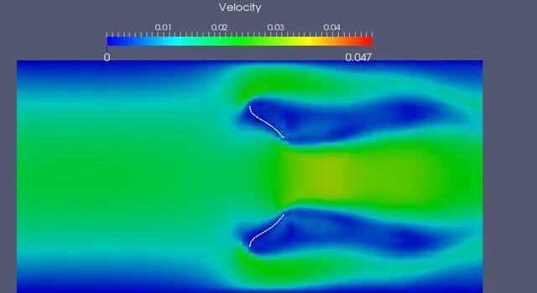
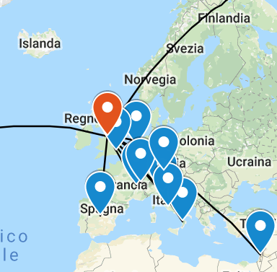
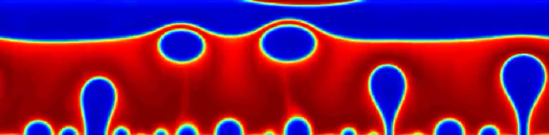
LBM at UoM
9
Why here?
How: from theory to implementation
Research groups and activities at MACE:
Modelling and Simulation Centre
LUMA & GASCANS
Thermofluids group
Microsystems group
SPHERIC: SPH vs LBM
Other institutions at UoM:
Computer Science
Biological Sciences
Chemical Engineering and Analytical Sciences
Biology Medicine and Health
Cell-Matrix research centre
Multiphysics modelling by LBM
Methodology
Applications
Biophysics
Energy &
mechanics
Improving accuracy and stability
Coding
HPC, GPU
GUI, pre- & post-proc
Beyond the Navier-Stokes equations
De Rosis & Tafuni (2022)
Comput Aid Civ Inf
National and international network
UKCOMES
École Centrale de Lyon
Universitè de Genève
New Jersey Institute of Technology
University of Tsukuba
Other academic and industrial partners
Fluid-structure interaction
Nucleate pool boiling

Slide 12

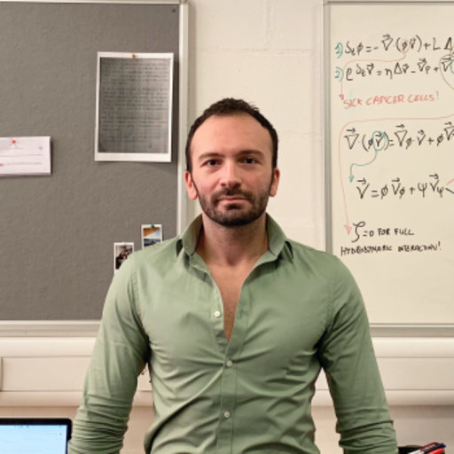
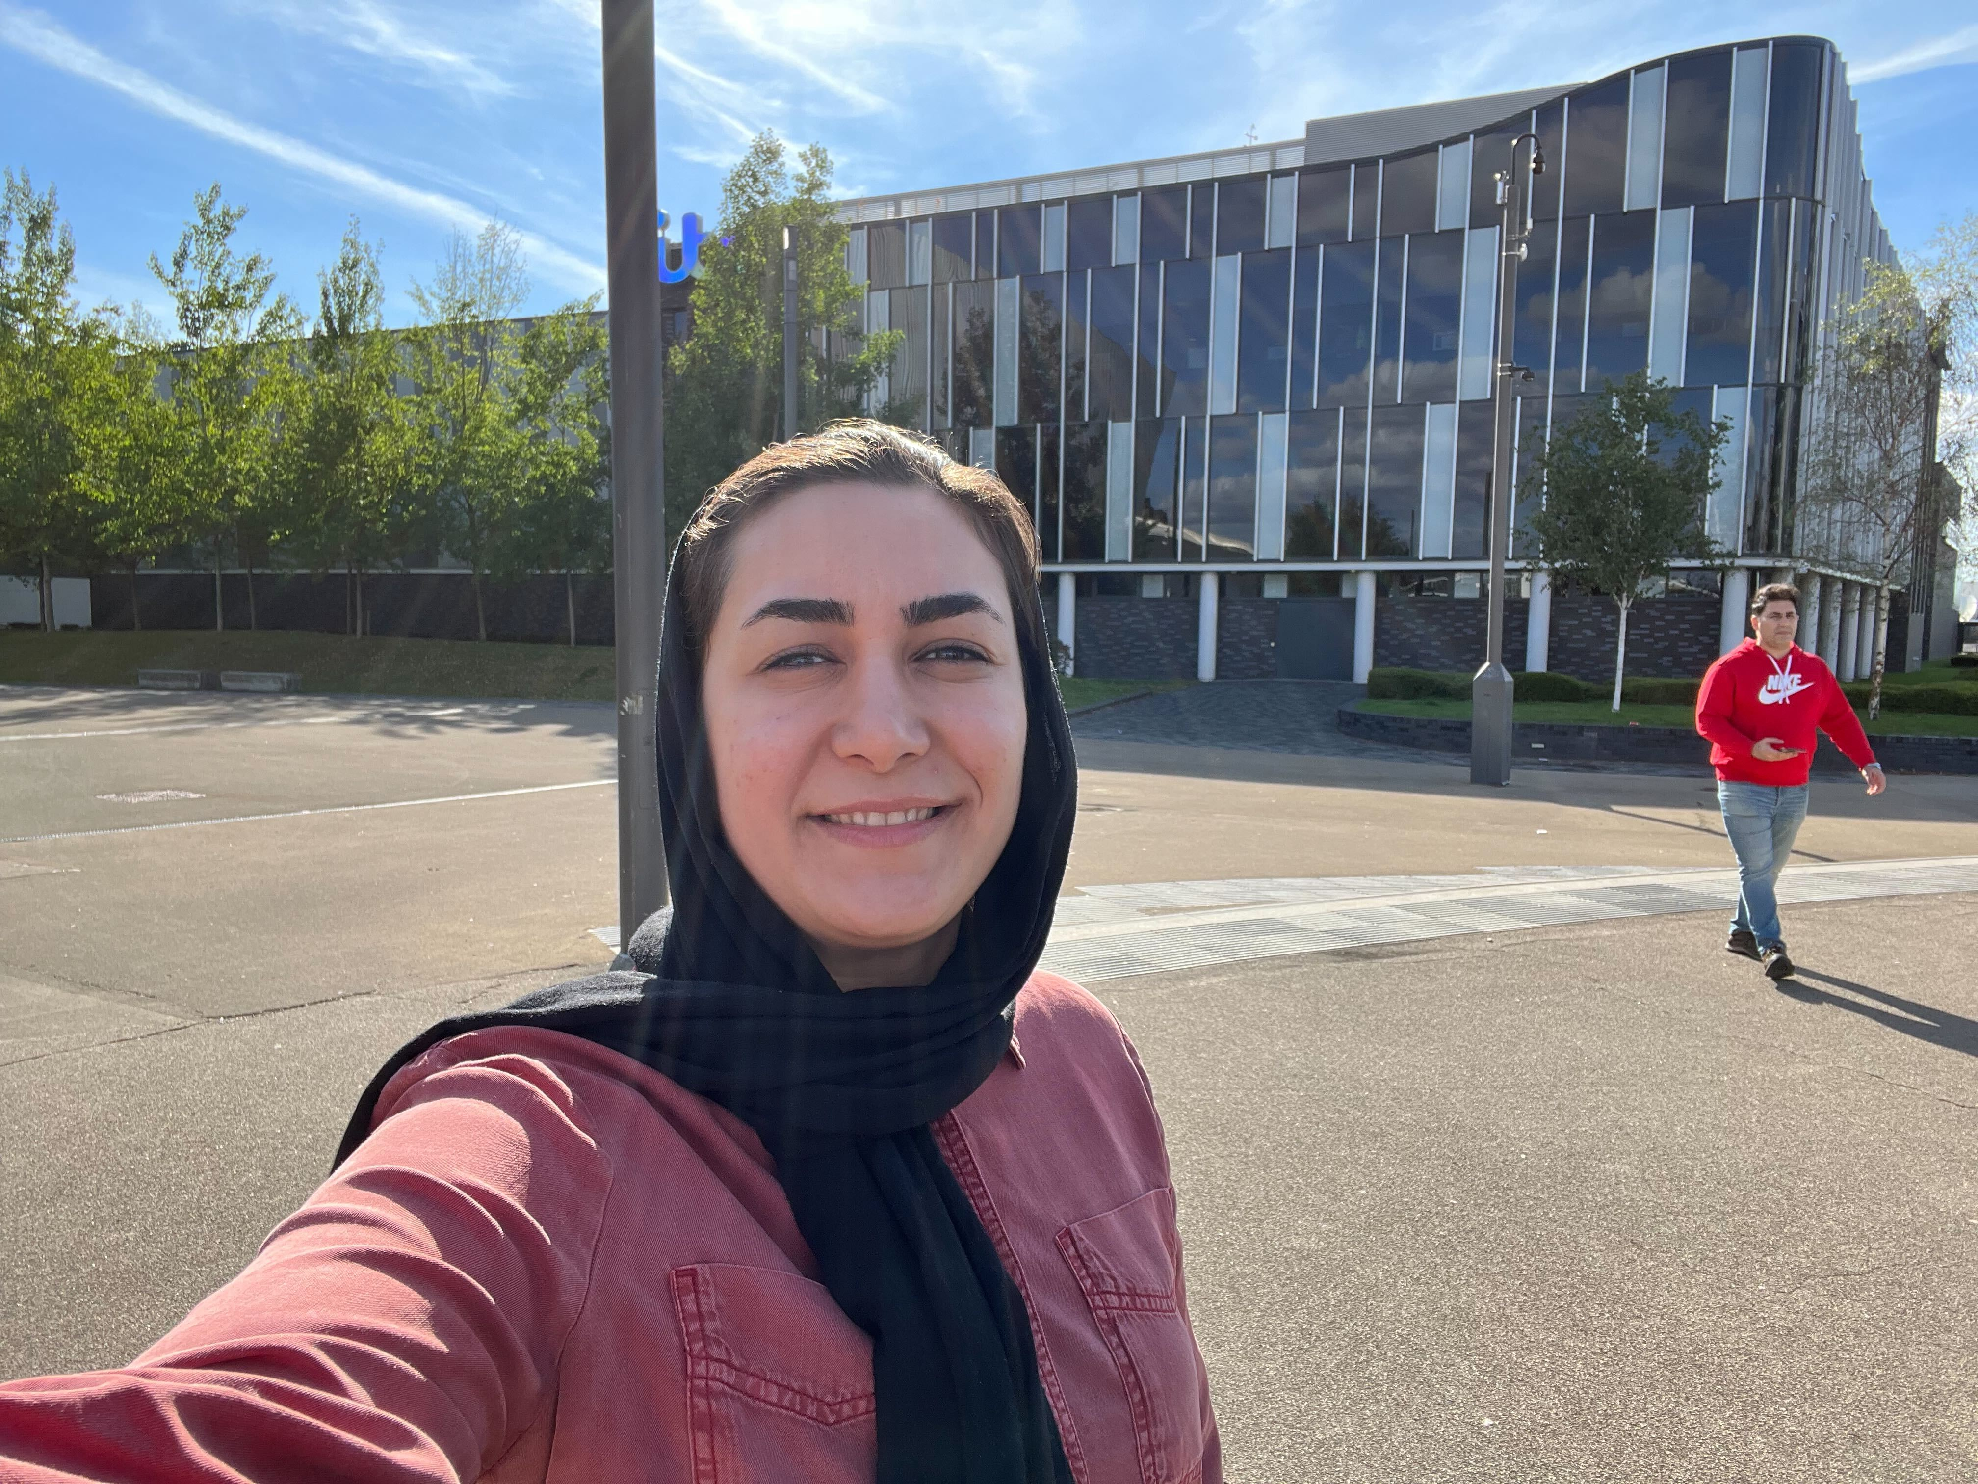

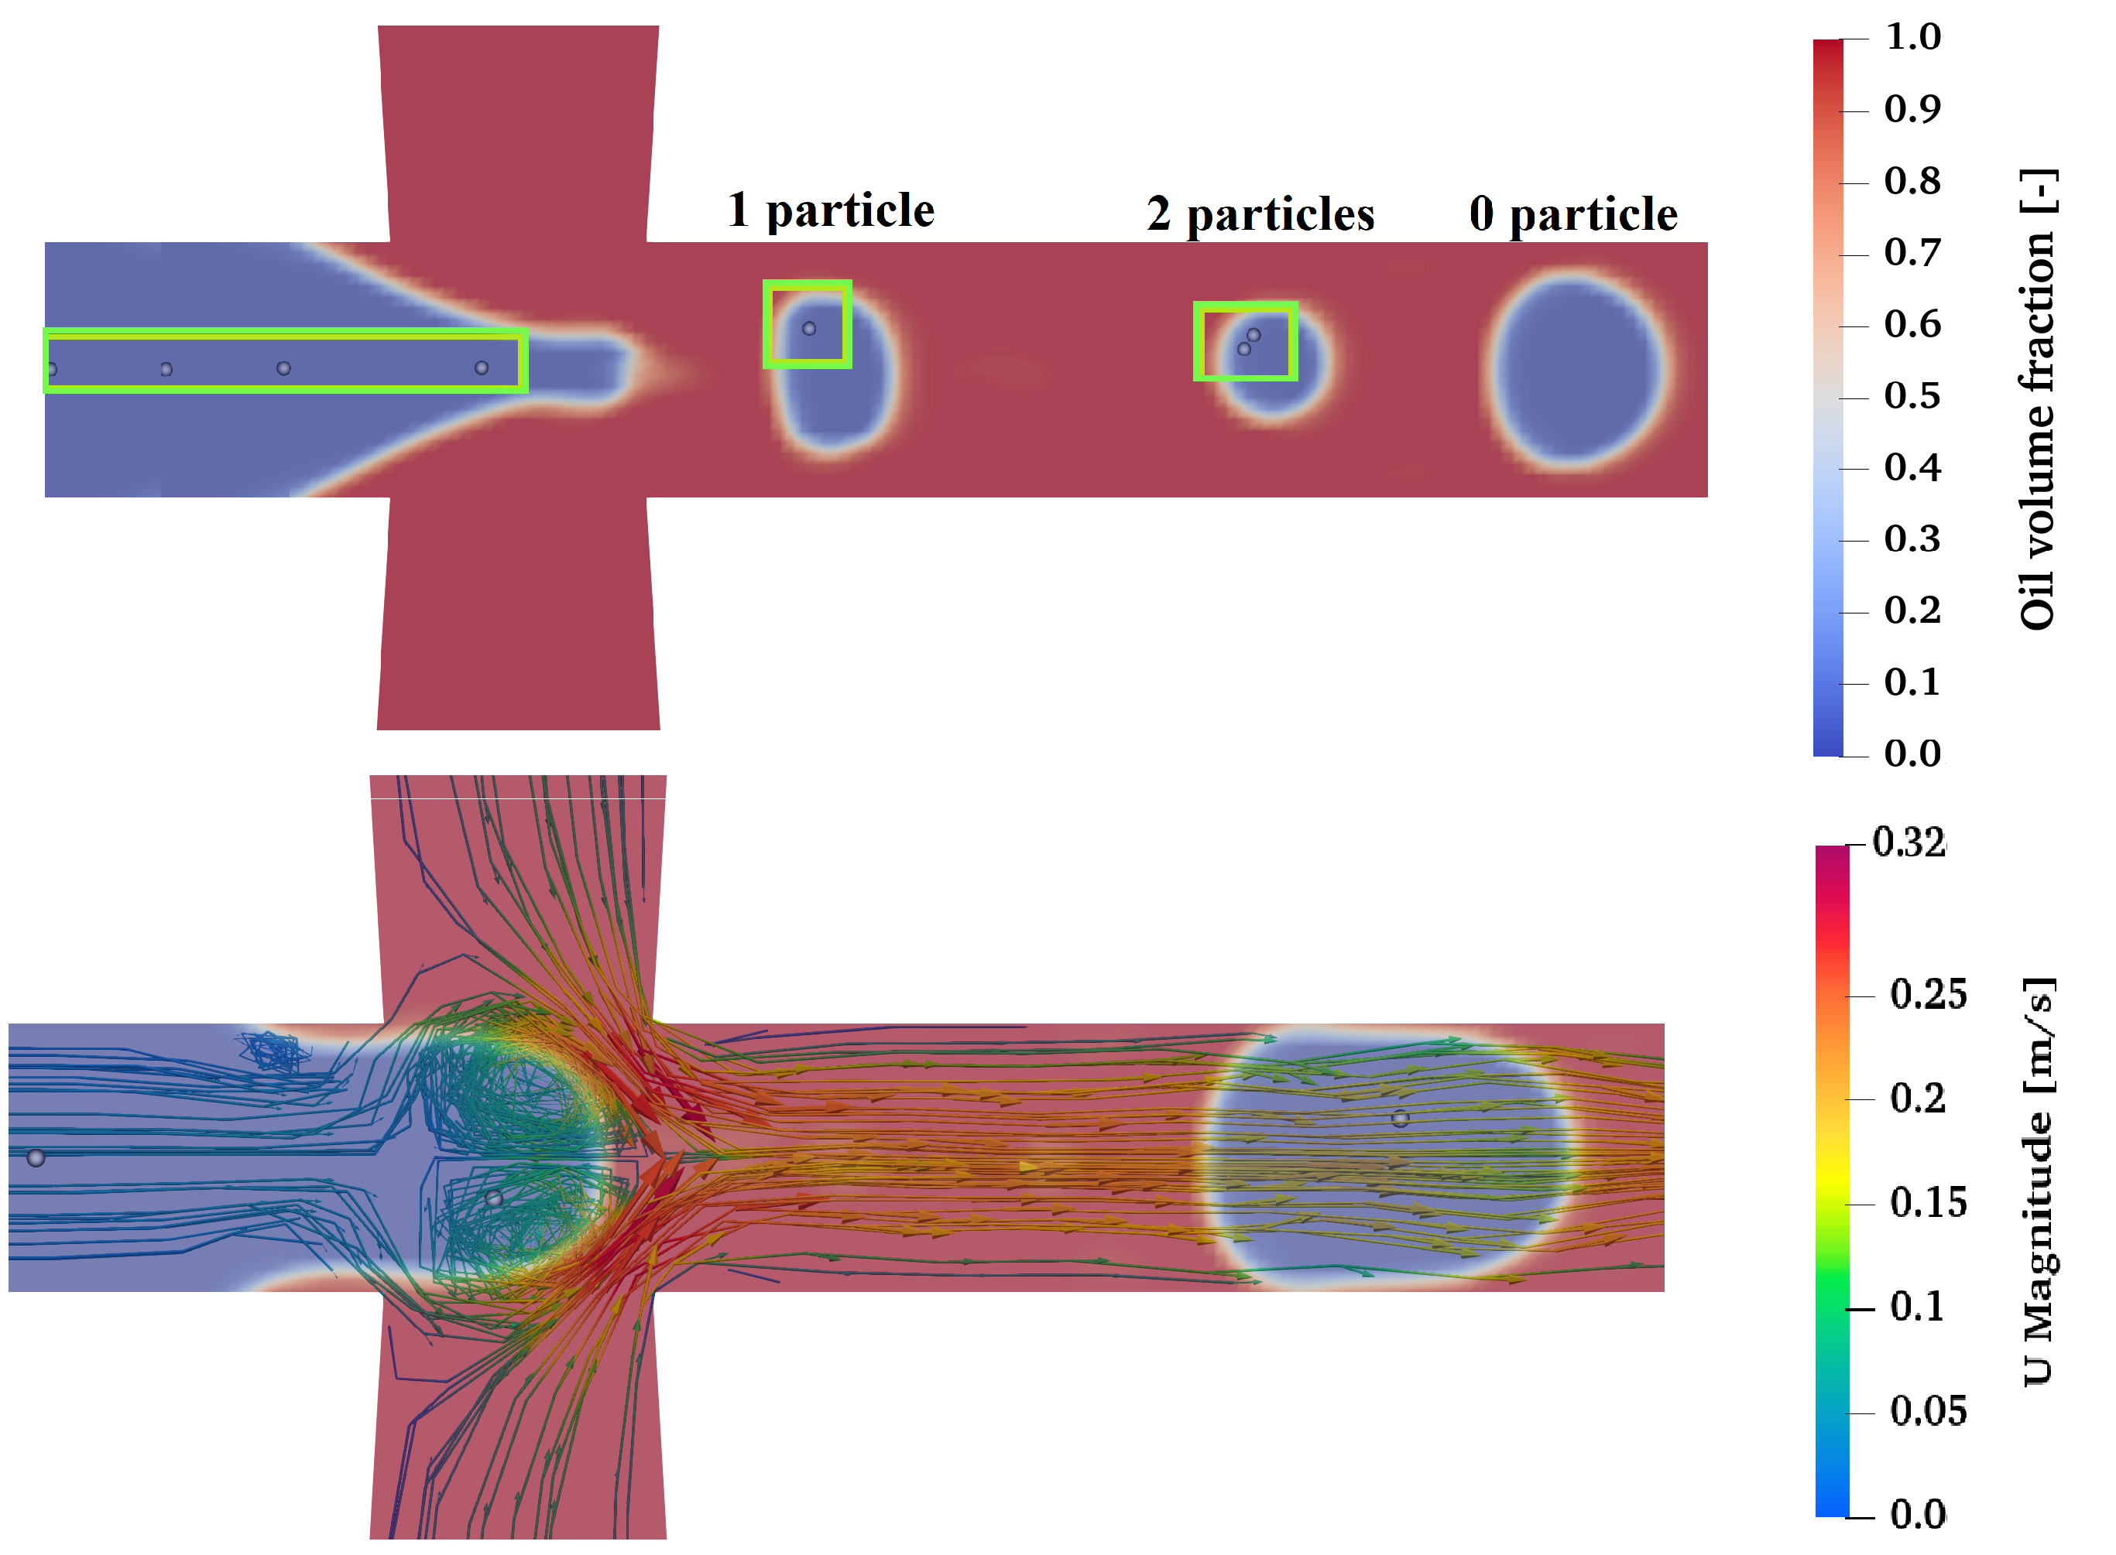
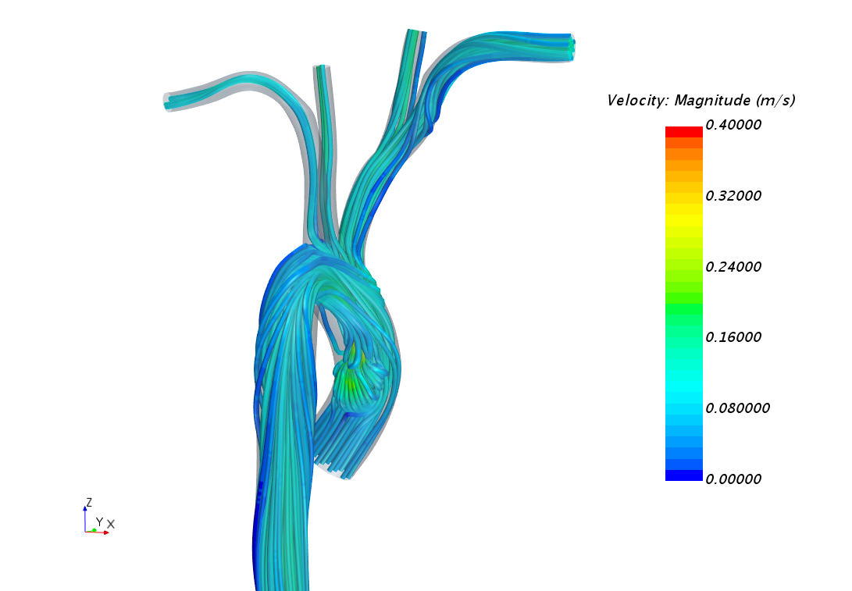
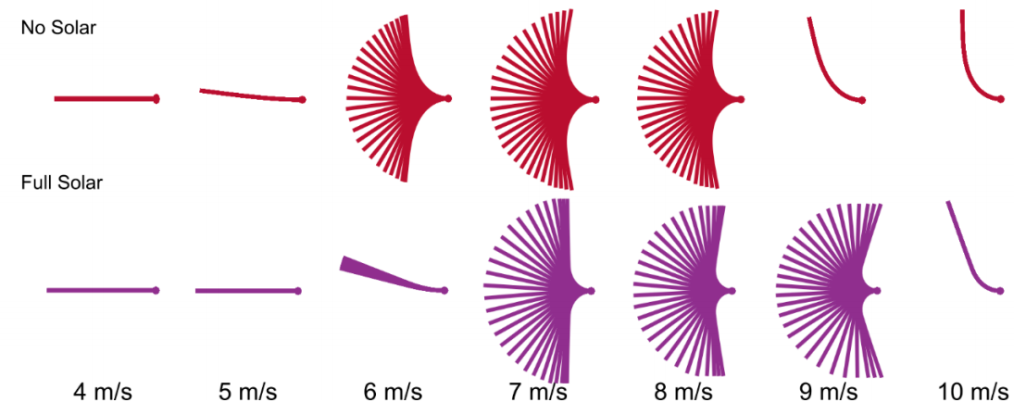
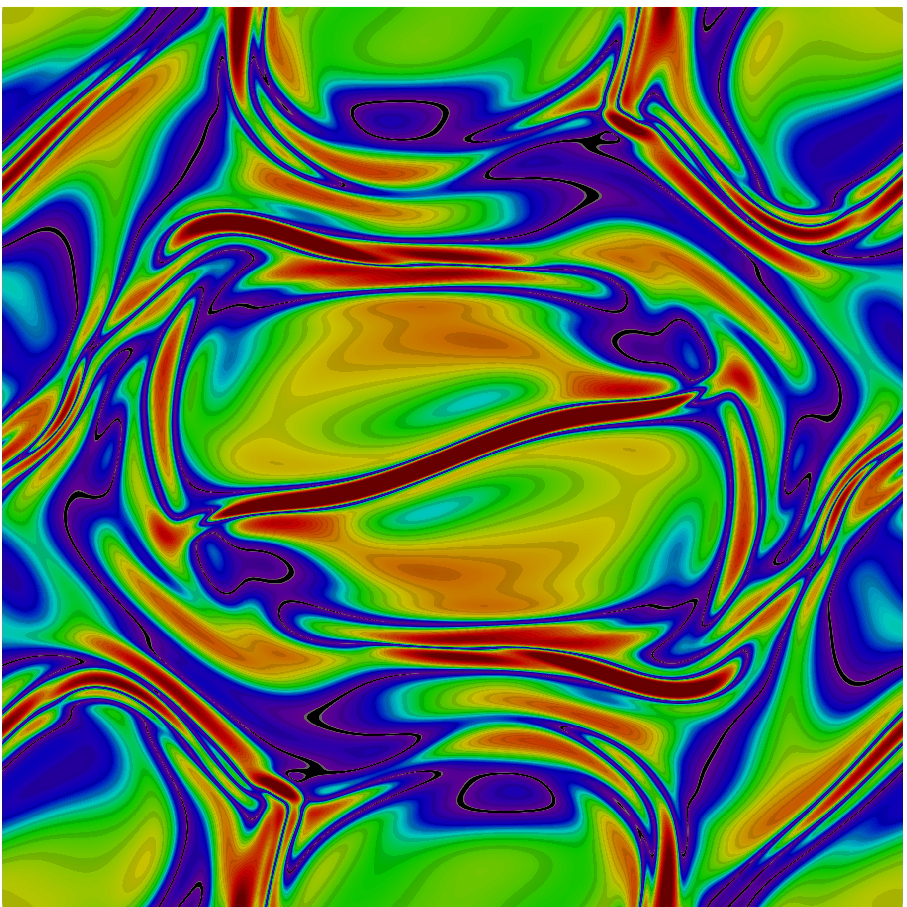

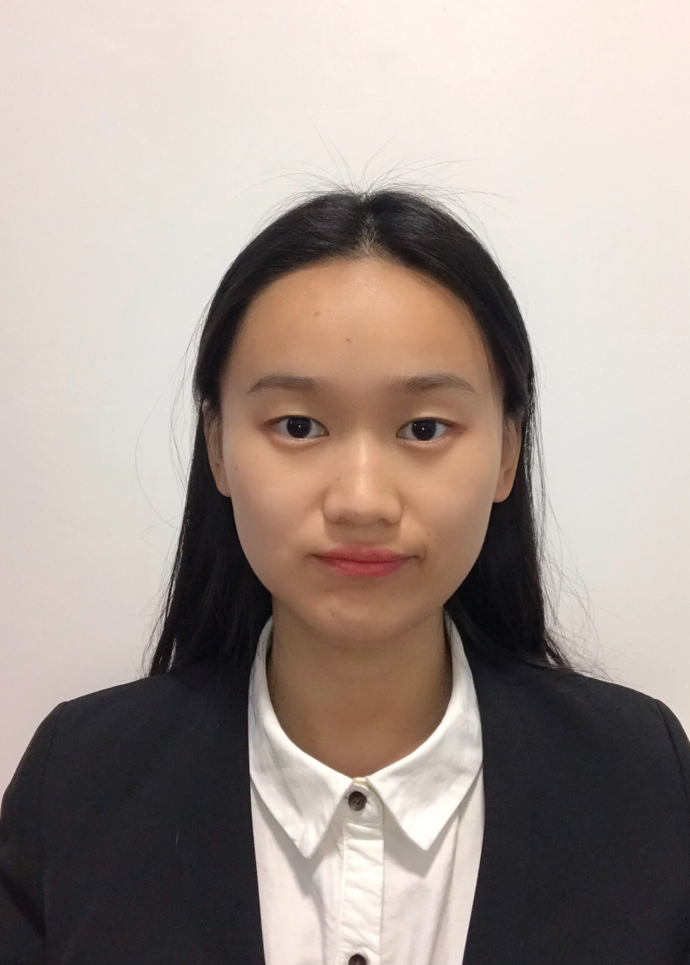


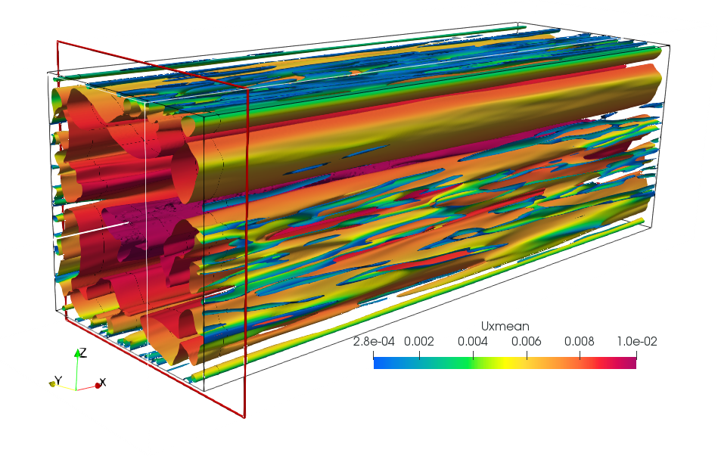
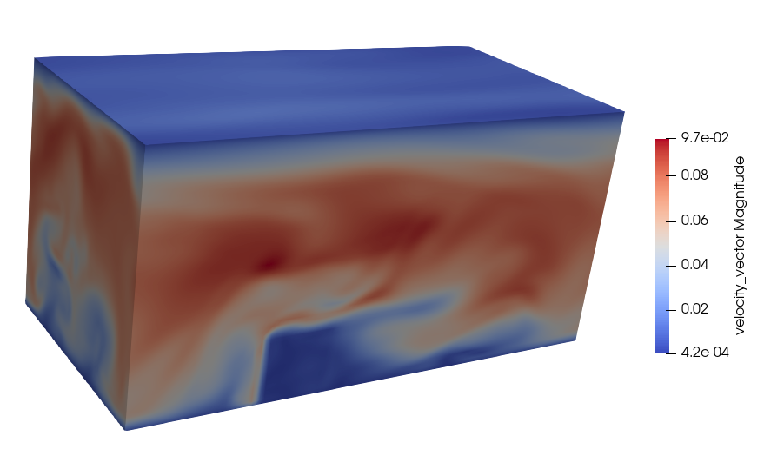
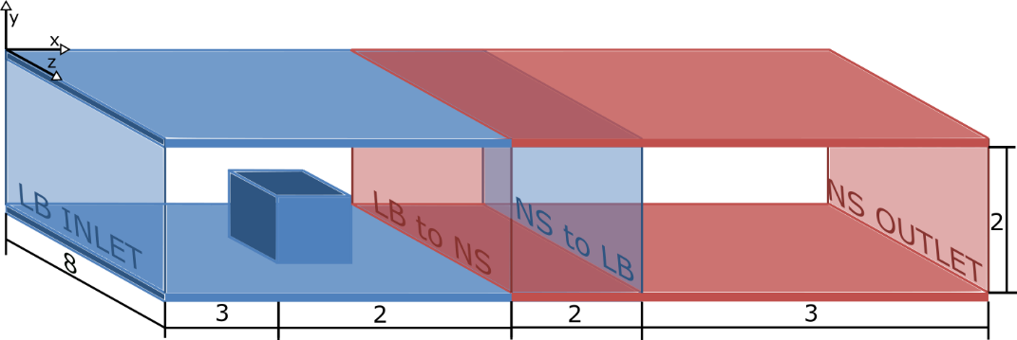
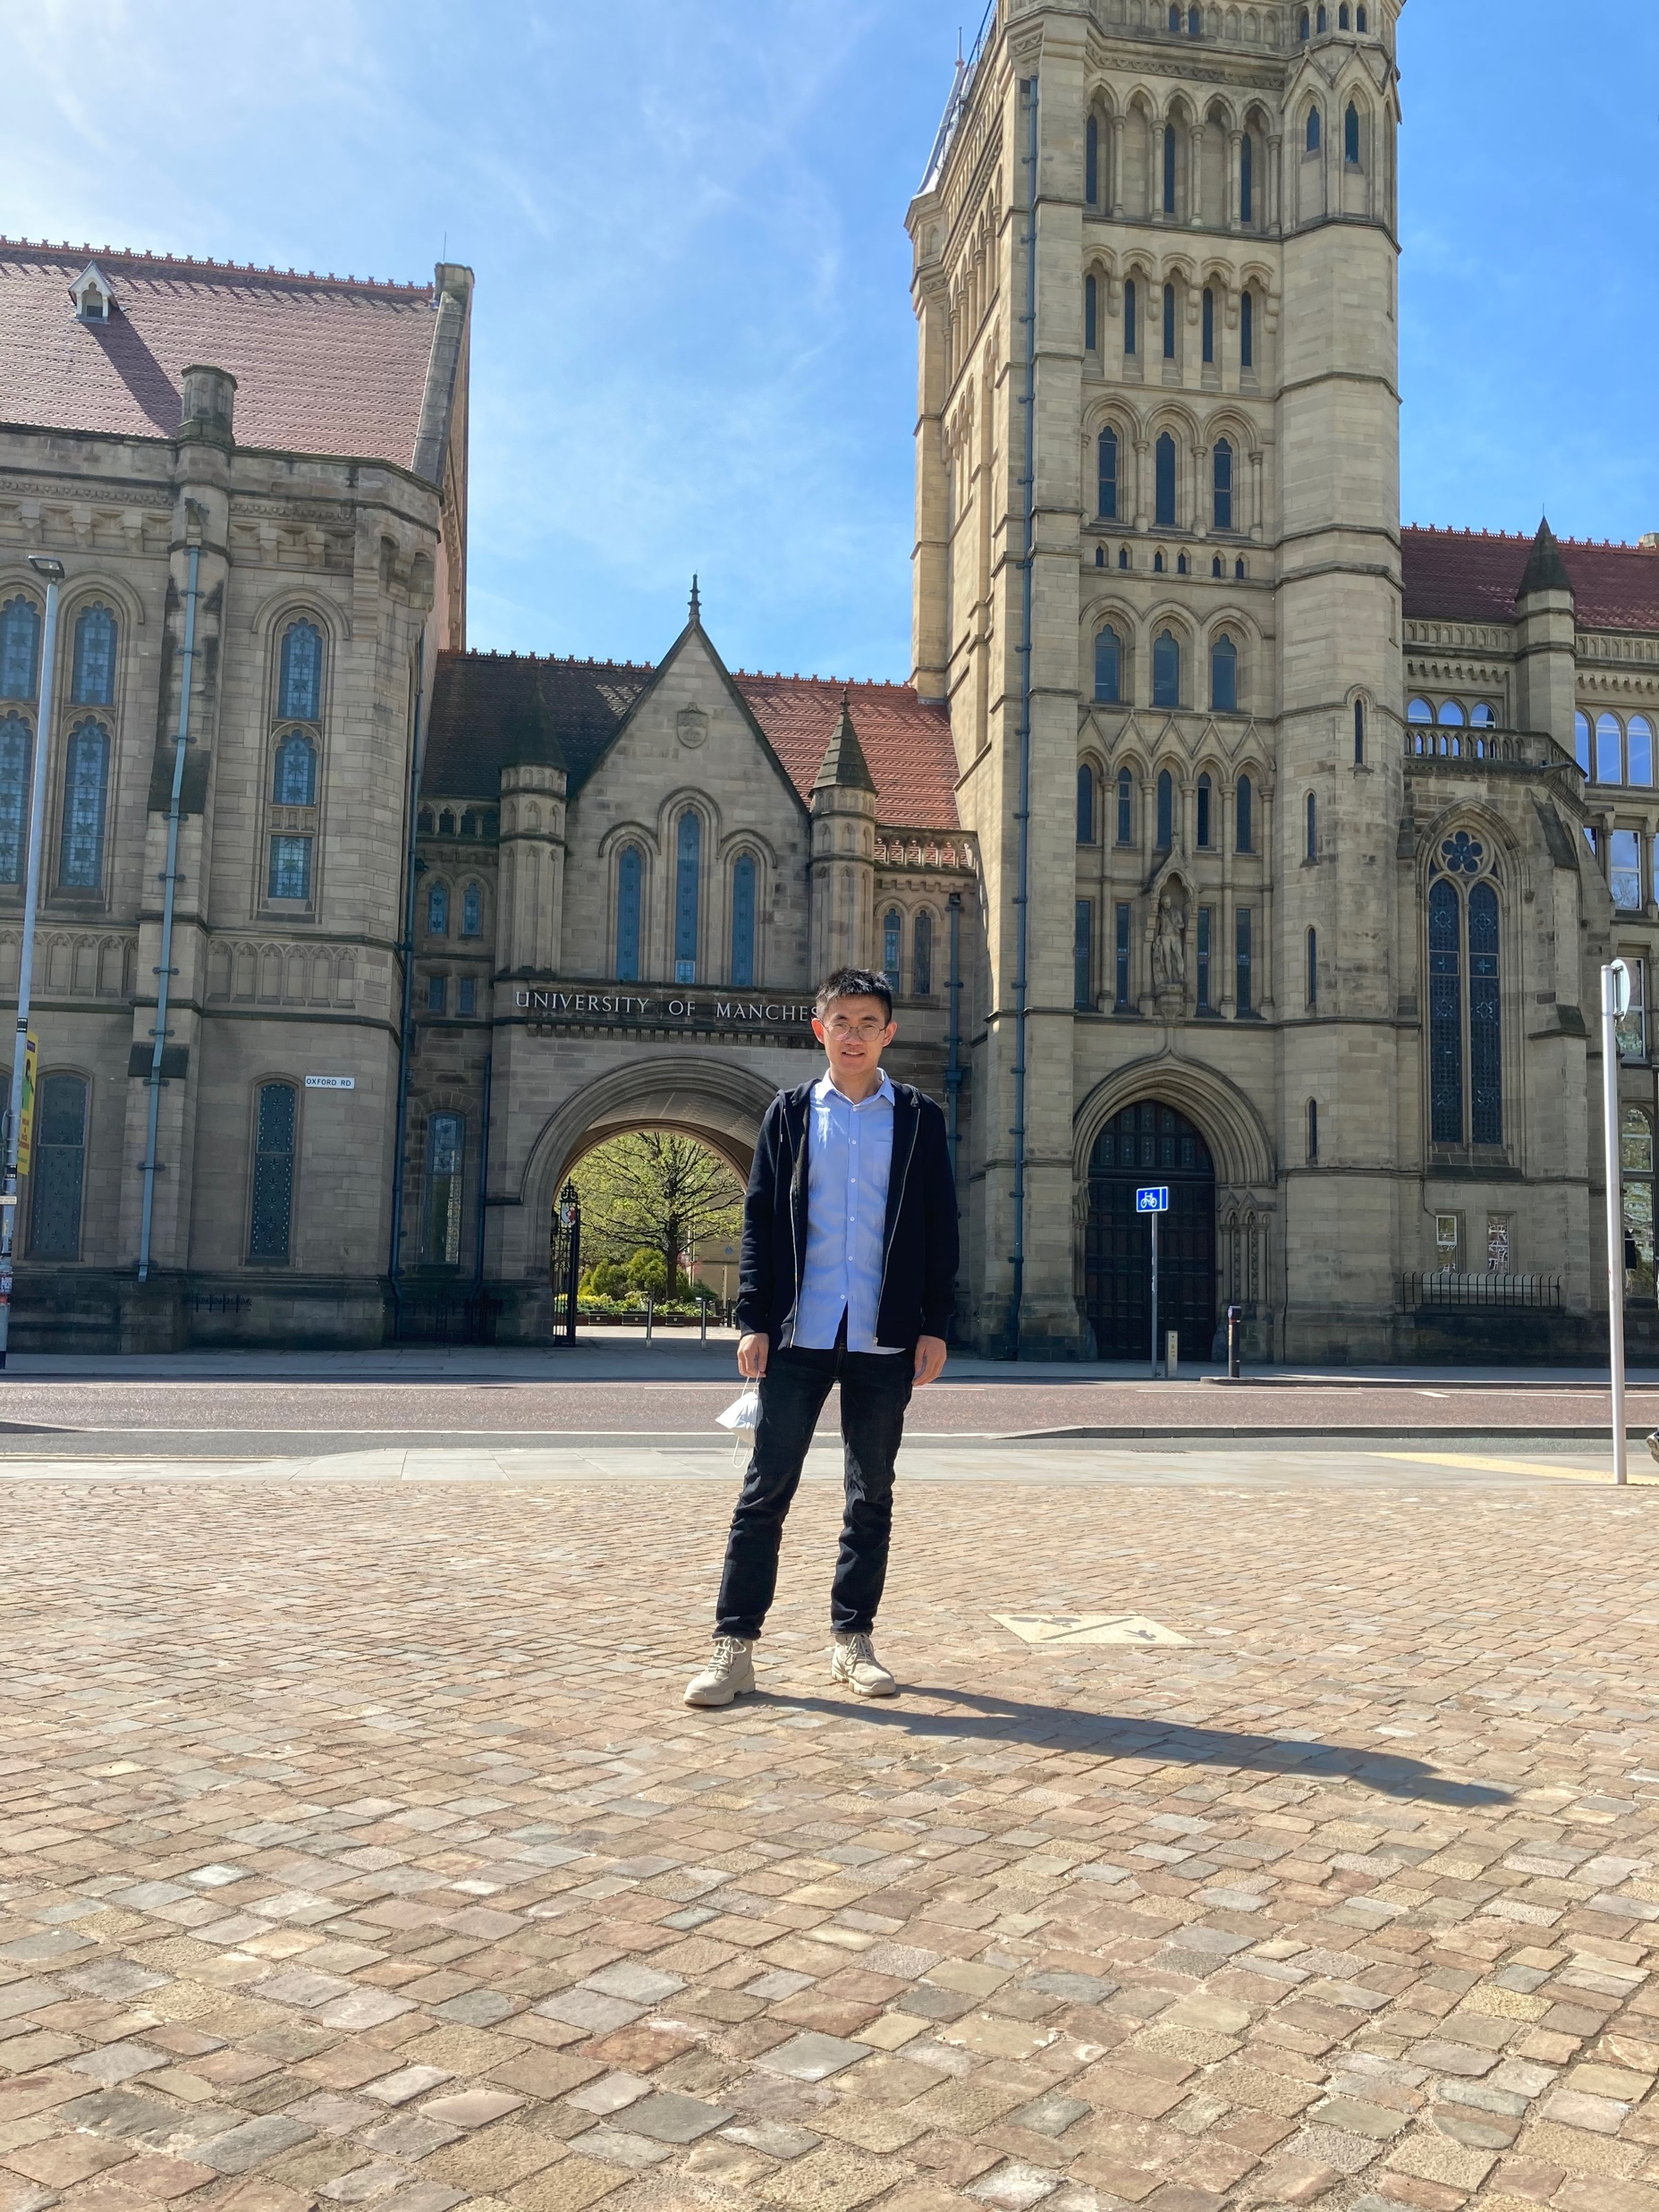
LBM at UoM: our group today
9
Alistair Revell (Professor)
LBM, LUMA, turbulence, aerodynamics
ADR (Lecturer)
Multiphysics modelling
Maryam Fatehifar (PhD student)
Multicomponent flows
Gabriela Lopez Santana (PhD student)
Cardiovascular flows
Ruizhi Liu (PhD student)
Advanced LBMs
Rong Wang (PhD student)
Atmospheric flows and wind farm
Marta Camps (PDRA)
LUMA, Coupling with FVM
Ian Hinder (Res Soft Eng)
FSI on GPUs
Yang Zhou (PhD student)
Boiling

Slide 13
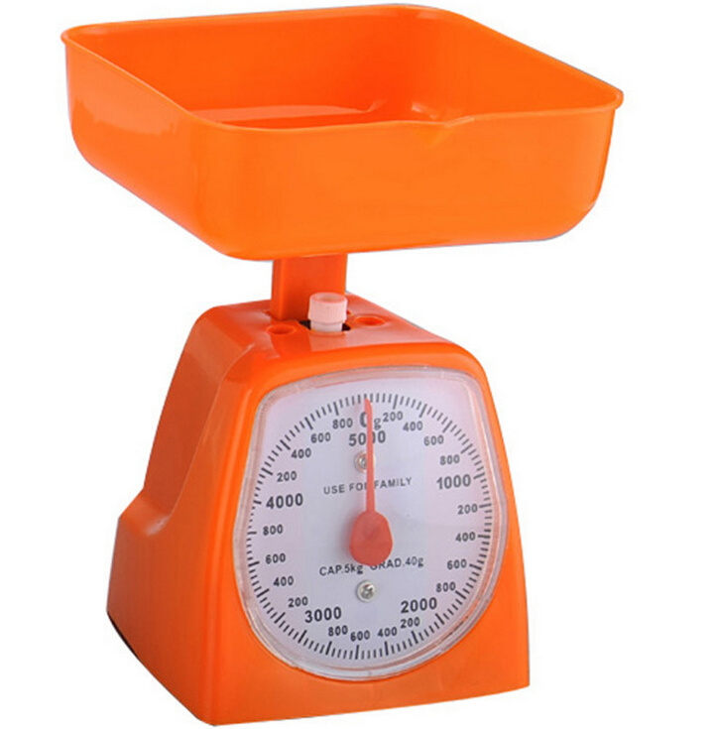

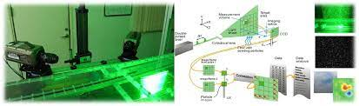
Linking macro and micro worlds
16
Macroscopic and microscopic scales
At the macroscopic level, a fluid is a continuous material with some properties and it obeys the Navier-Stokes equations. Pressure, density and velocity are continuous variables which can be measured.

Slide 14
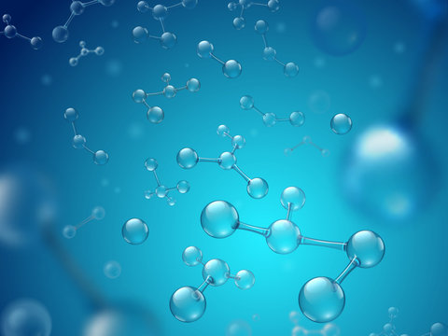
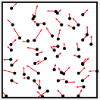
Linking macro and micro worlds
16
Macroscopic and microscopic scales
At the microscopic level, we play another game. Here, the fluid is an ensemble of molecules with an unpredictable (chaotic) behaviour and it loses its apparent global coherence. The apparent continuity of the fluid is broken.
Establishing the link between macro and micro worlds is instrumental to a better understanding of the fluid behaviour.

Slide 15
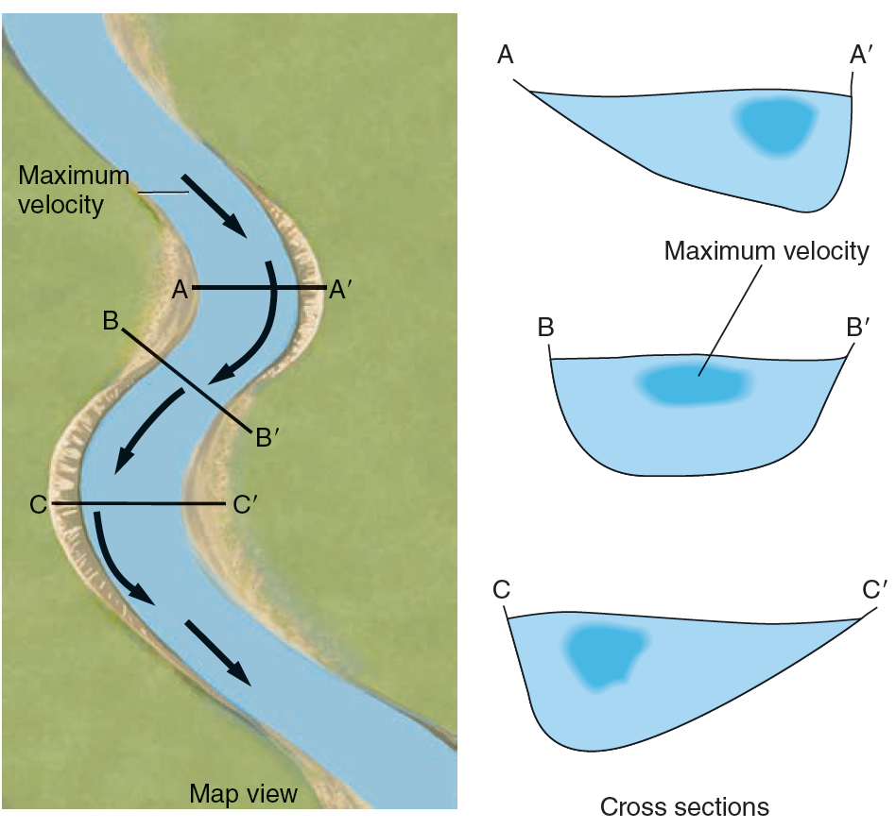
Linking macro and micro worlds
16
Macroscopic and microscopic scales
At the macroscopic level, we can visualise and measure density and velocity.
At the microscopic level, how can we define density and velocity while molecules move in a disordered way?

Slide 16
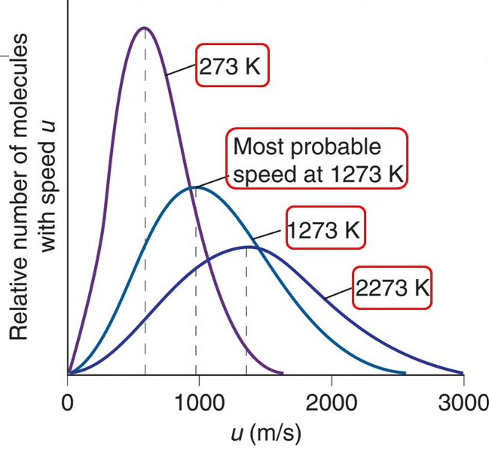
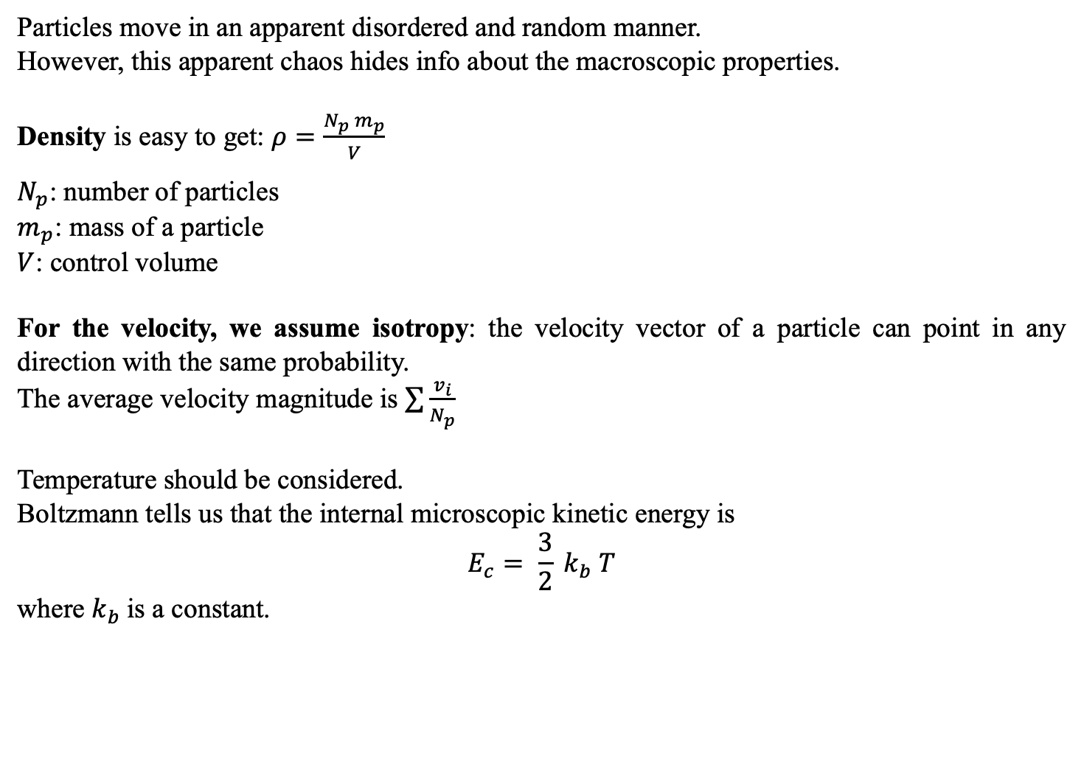
Density and velocity at the microscopic scale
16
Particles move in an apparent disordered and random manner.
However, this apparent chaos hides info about the macroscopic properties.
Density is easy to get: $ρ=\frac{N_{p} m_{p}}{V}$
$N_{p}$: number of particles
$m_{p}$: mass of a particle
$V$: control volume
For the velocity, we assume isotropy: the velocity vector of a particle can point in any direction with the same probability.
The average velocity magnitude is $\sum{\frac{v_{i}}{N_{p}}}$
Temperature should be considered.
Boltzmann tells us that the internal microscopic kinetic energy is
$$E_{c}= \frac{3}{2} k_{b} T$$
where $k_{b}$is a constant.

Slide 17
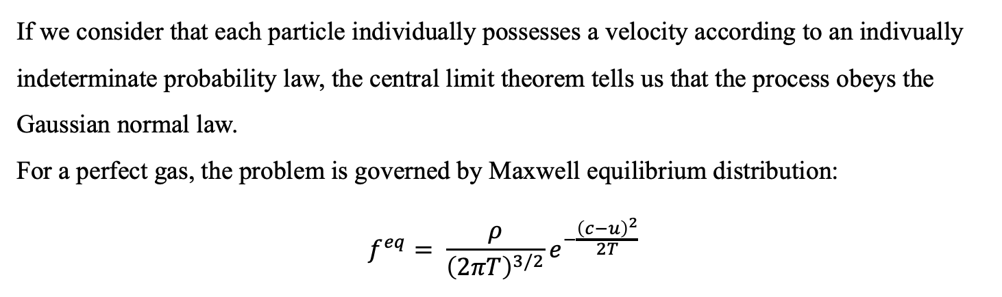
Boltzmann-Maxwell distribution of speed
16
If we consider that each particle individually possesses a velocity according to an indivually indeterminate probability law, the central limit theorem tells us that the process obeys the Gaussian normal law.
For a perfect gas, the problem is governed by Maxwell equilibrium distribution:
$$f^{eq}= \frac{ρ}{{\left(2πT\right)}^{3/2}}e^{−\frac{{\left(c−u\right)}^{2}}{2T}}$$

Slide 18
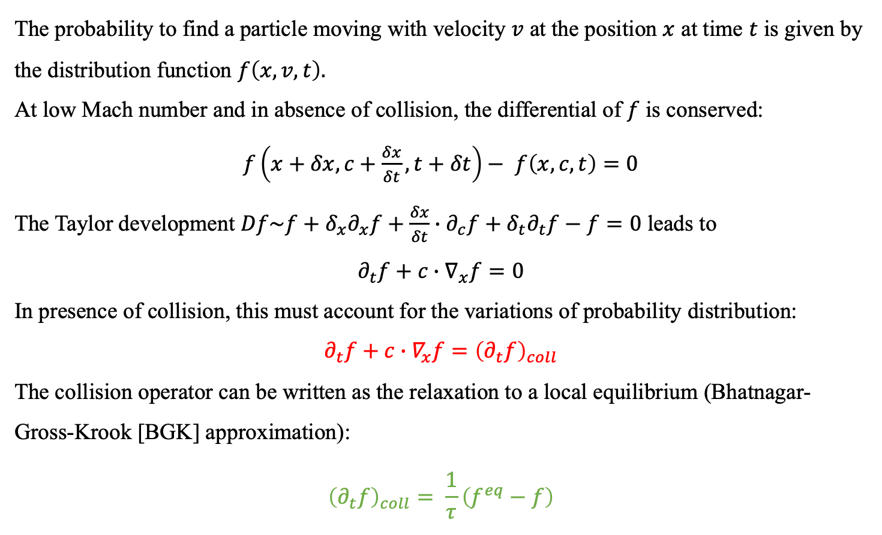
Boltzmann equation
16
The probability to find a particle moving with velocity $v$ at the position $x$ at time $t$ is given by the distribution function $f\left(x,v,t\right).$
At low Mach number and in absence of collision, the differential of $f$ is conserved:
$f\left(x+δx,c+\frac{δx}{δt},t+δt\right)−$ $f\left(x,c,t\right)=0$
The Taylor development $Df\sim f+δ_{x}∂_{x}f+\frac{δx}{δt}∙∂_{c}f+δ_{t}∂_{t}f−f=0$ leads to
$$∂_{t}f+c∙∇_{x}f=0$$
In presence of collision, this must account for the variations of probability distribution:
$$∂_{t}f+c∙∇_{x}f={\left(∂_{t}f\right)}_{coll}$$
The collision operator can be written as the relaxation to a local equilibrium (Bhatnagar-Gross-Krook [BGK] approximation):
$${\left(∂_{t}f\right)}_{coll}= \frac{1}{τ}\left(f^{eq}−f\right)$$

Slide 19
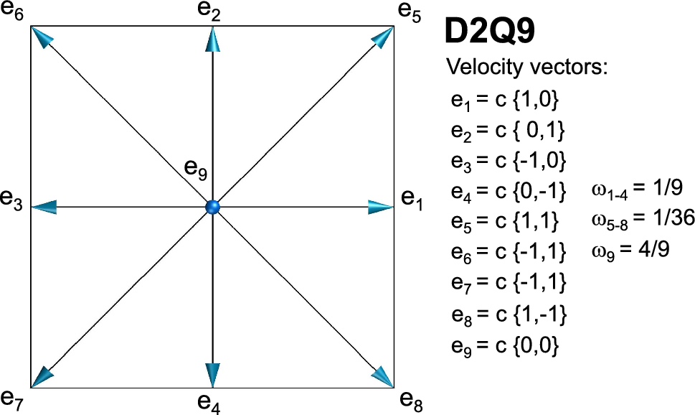
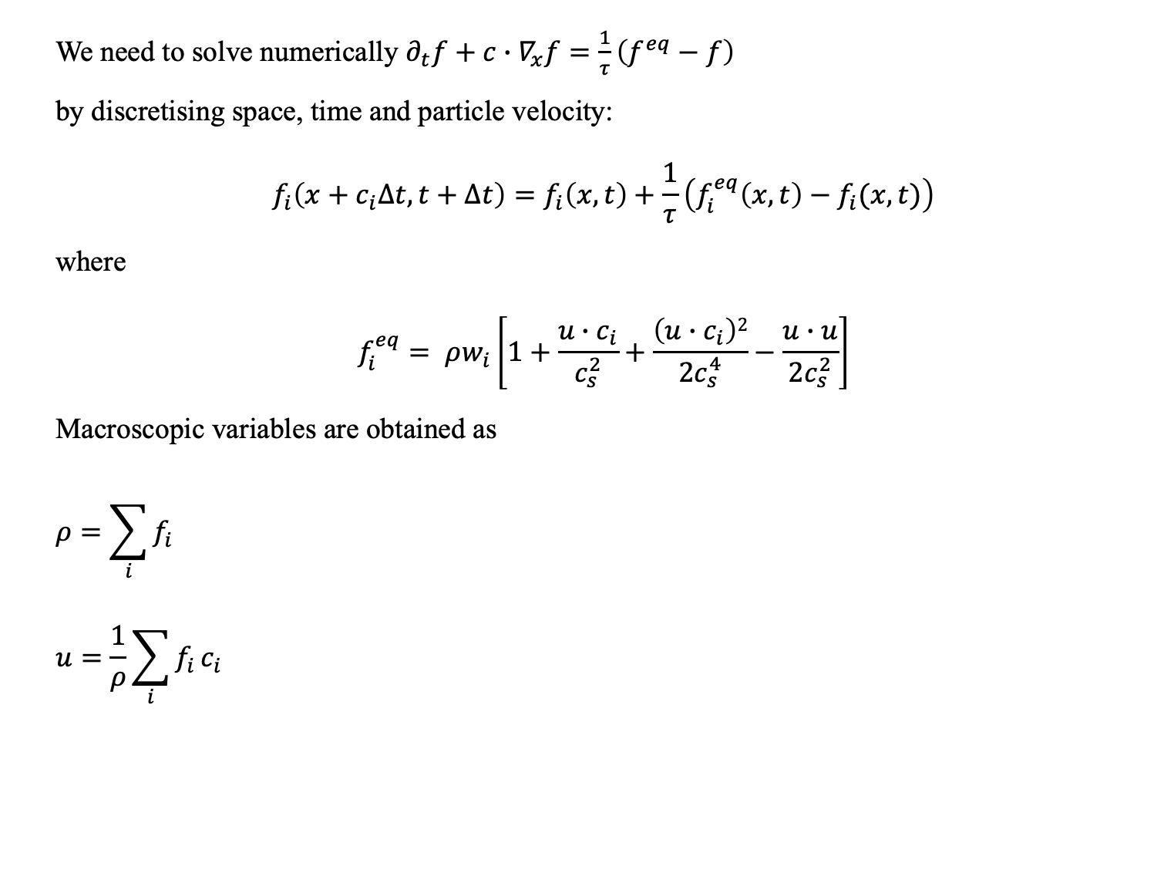
Discrete Boltzmann equation
16
We need to solve numerically $∂_{t}f+c∙∇_{x}f=\frac{1}{τ}\left(f^{eq}−f\right)$
by discretising space, time and particle velocity:
$$f_{i}\left(x+c_{i}∆t,t+∆t\right)=f_{i}\left(x,t\right)+\frac{1}{τ}\left(f_{i}^{eq}\left(x,t\right)−f_{i}(x,t)\right)$$
where
$$f_{i}^{eq}= ρw_{i}\left[1+\frac{u∙c_{i}}{c_{s}^{2}}+\frac{\left(u∙c_{i}\right)2}{{2c}_{s}^{4}}−\frac{u∙u}{2c_{s}^{2}}\right]$$
Macroscopic variables are obtained as
$$ρ=\sum_{i}{f_{i}}$$
$$u=\frac{1}{ρ}\sum_{i}{f_{i}}c_{i}$$

Slide 20
Thanks for your attention!
printf(“ Questions? ”);
if(question)
if(haveAnswer)
giveAnswer();
else
pretendTheQuestionIsIllPosed();
end
else
printf(“ Thank you! ”);
end

